Slide 1
QA Cinema Project
Team PO

Slide 2

Introduction
Who are we?
Jordan Lewis
Mark Gasmido
Mohamed Sajath Raffeek
Philip Ugona
Ryan Glennerster

Slide 3
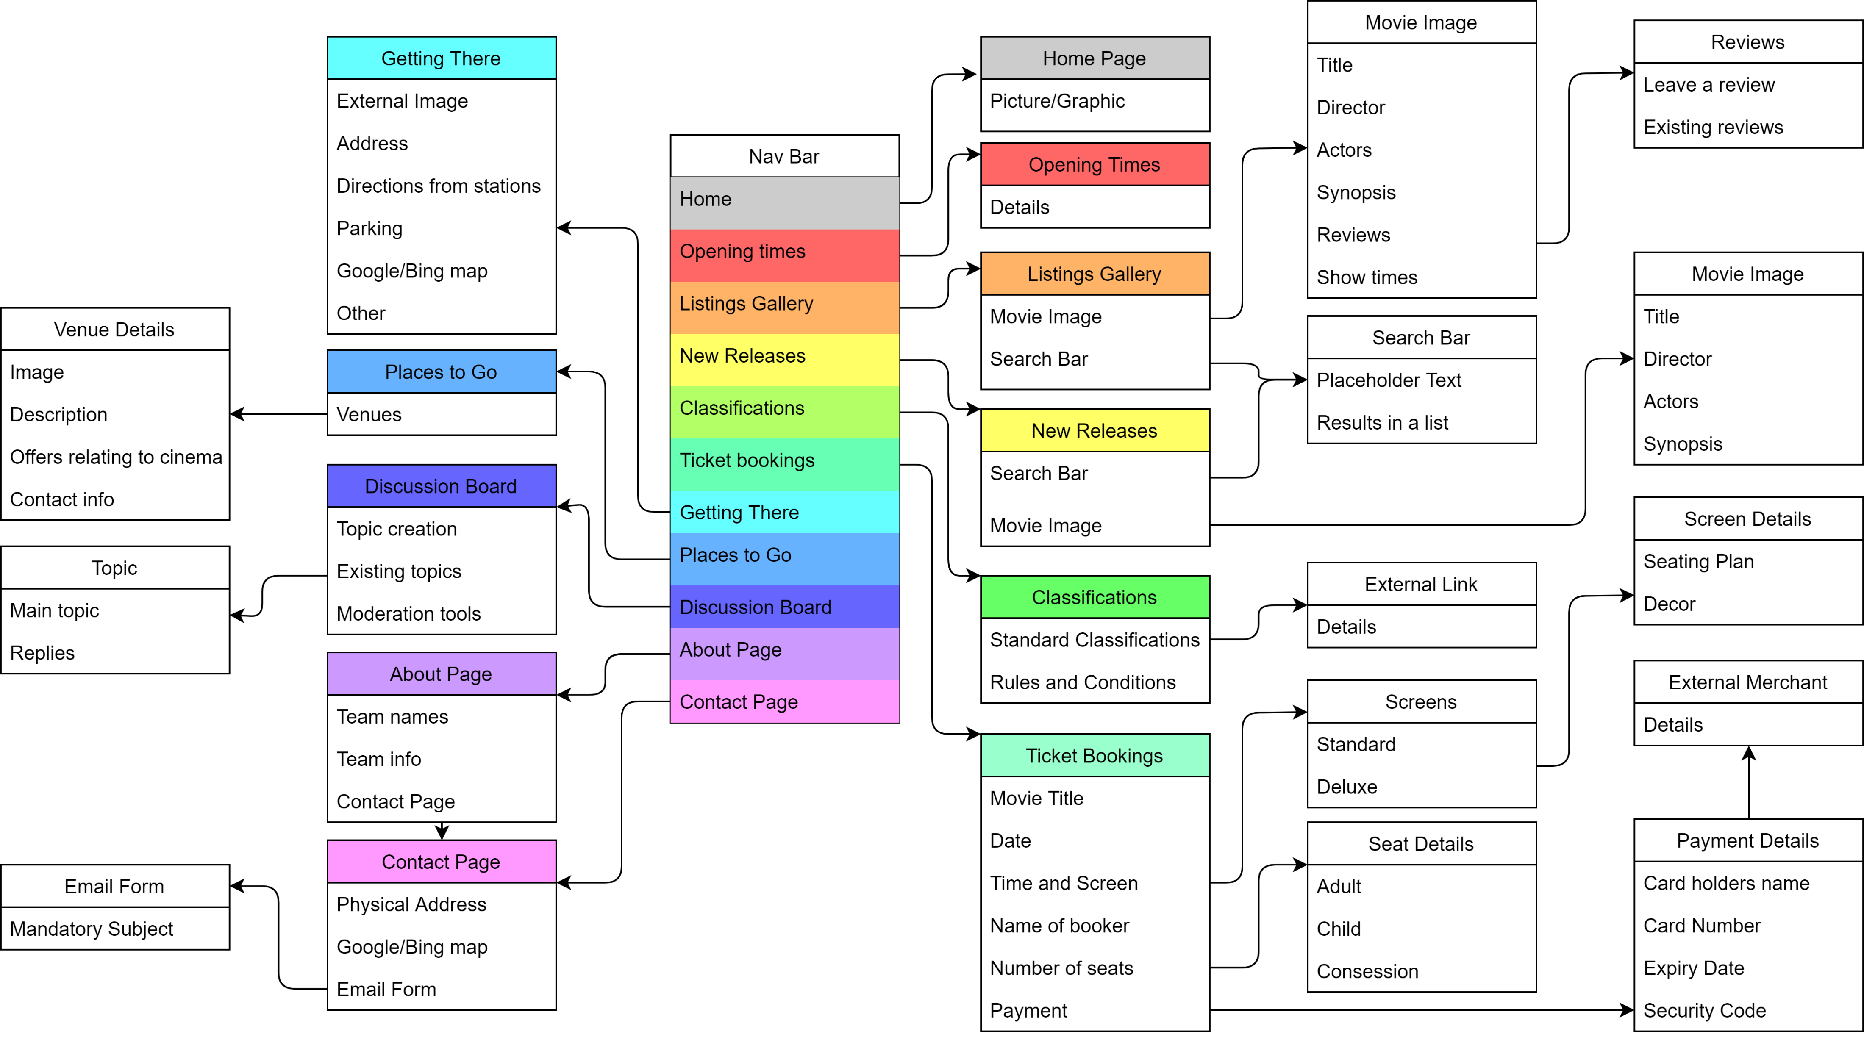
Introduction
How did we approach the Specification?

Slide 4
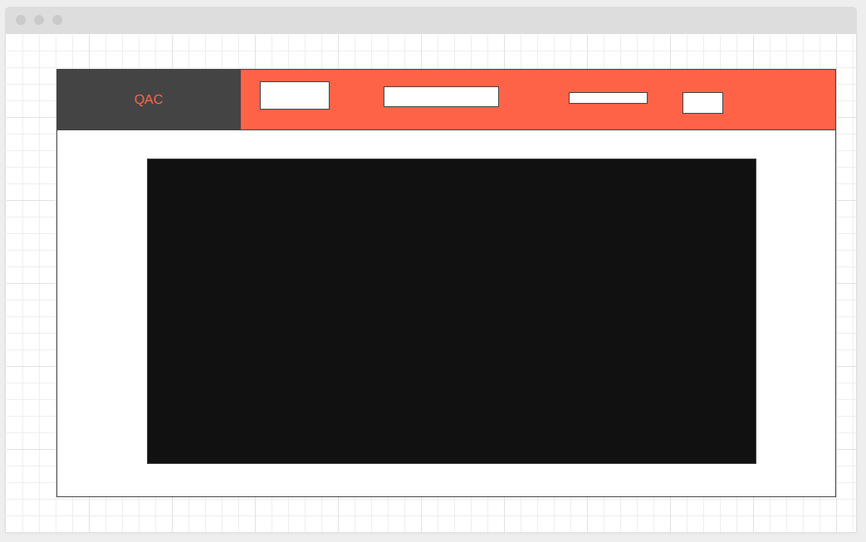
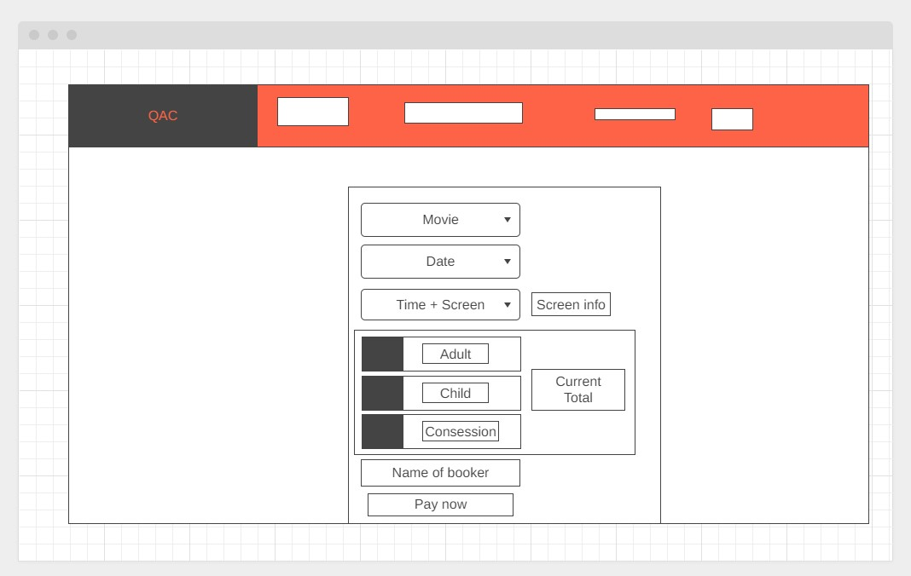
Concept

Slide 5
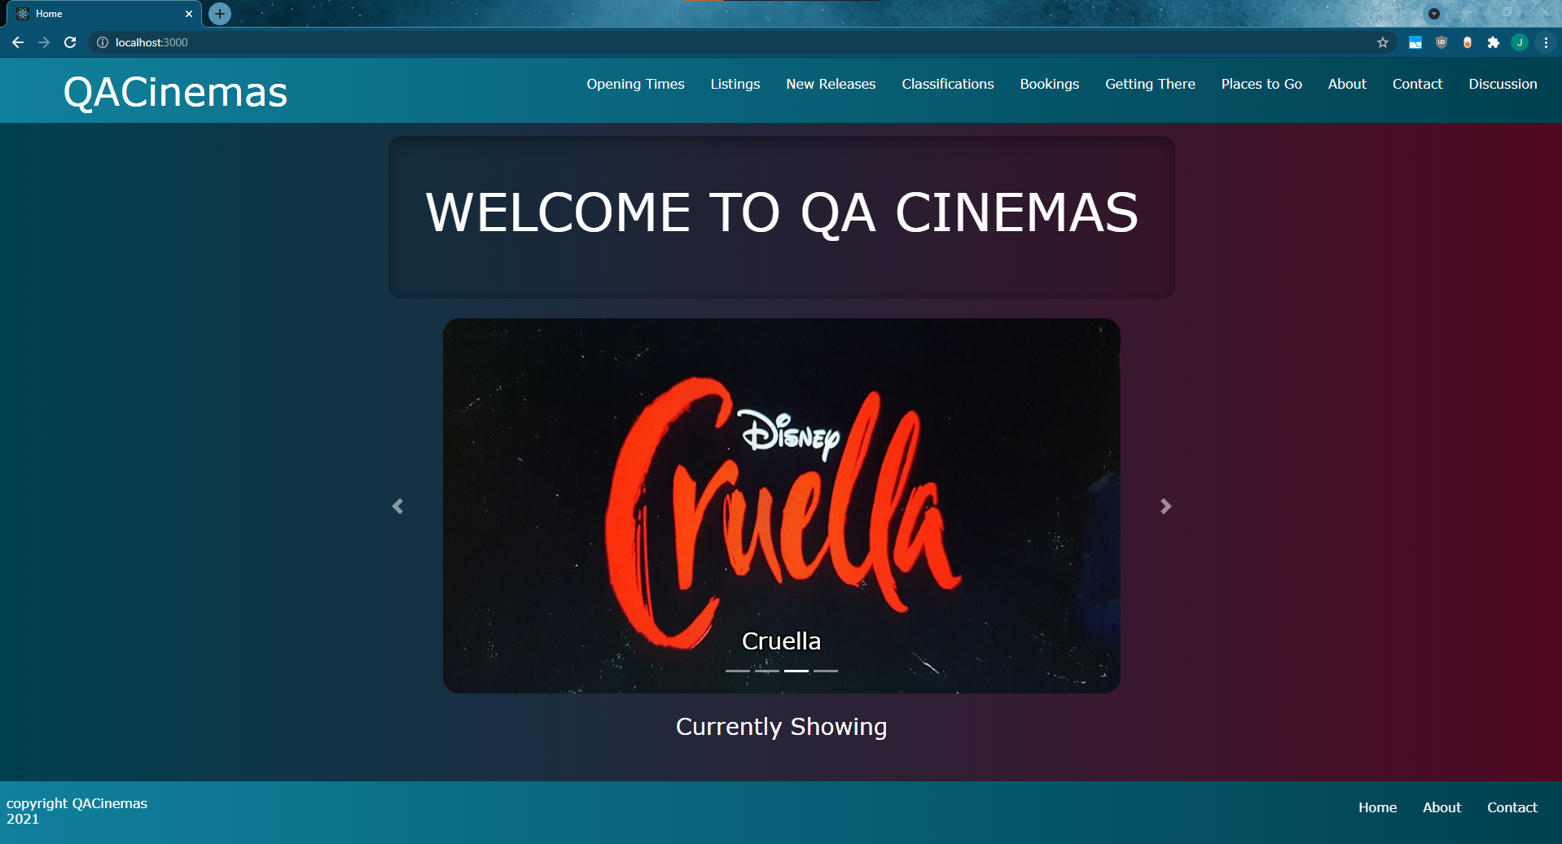
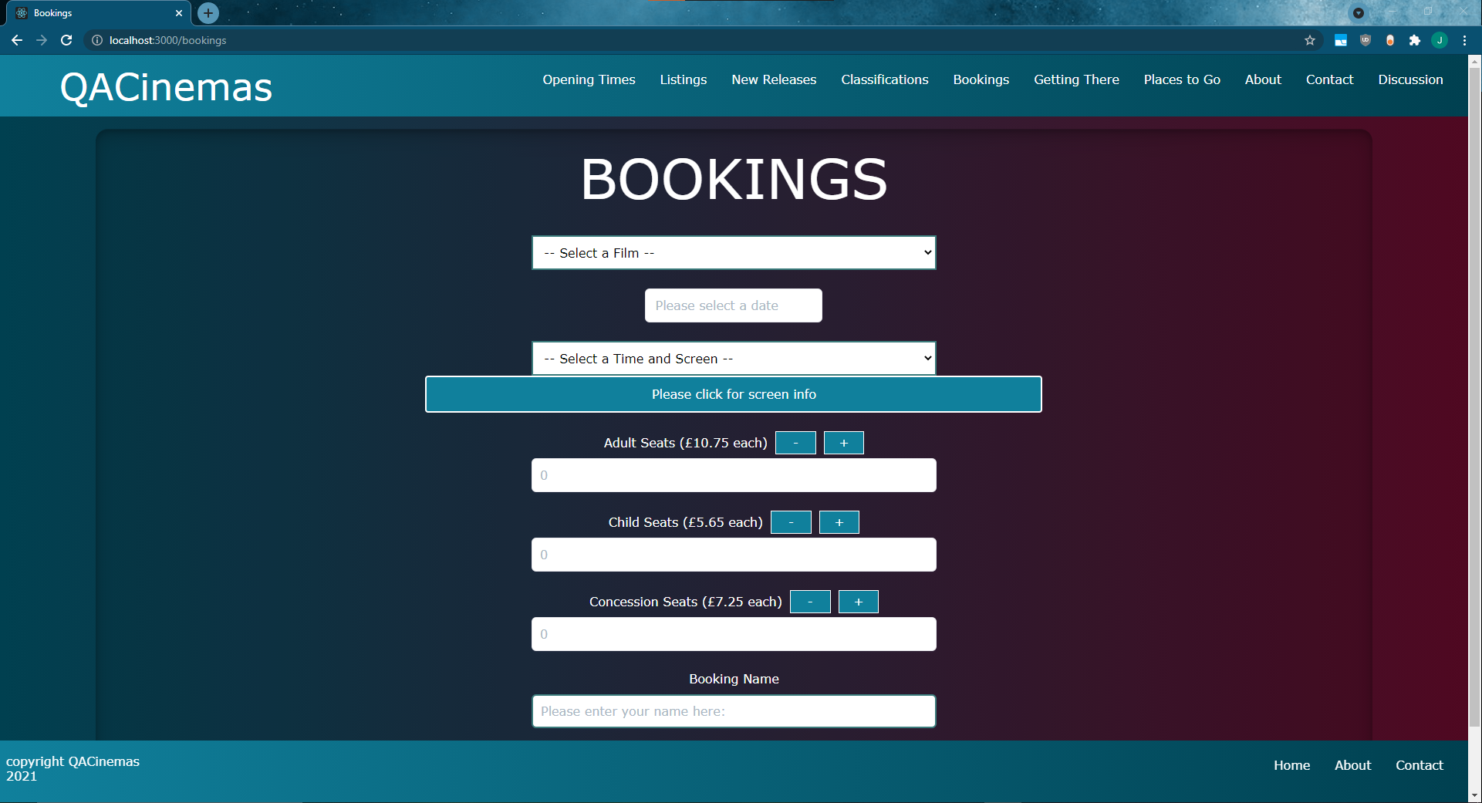
Concept

Slide 6
Sprint Plan
What needed to be included?
Front-end
Back-end
Testing
What did you hope to achieve?

Slide 7
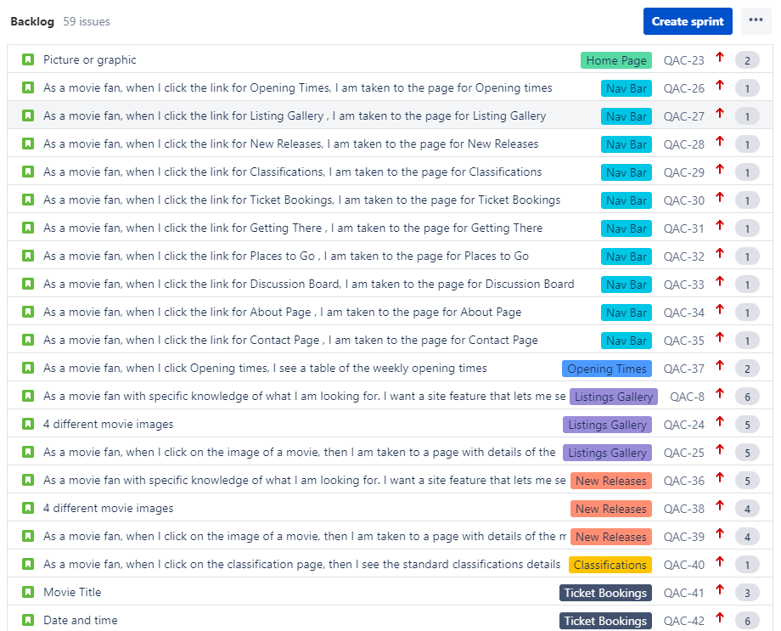
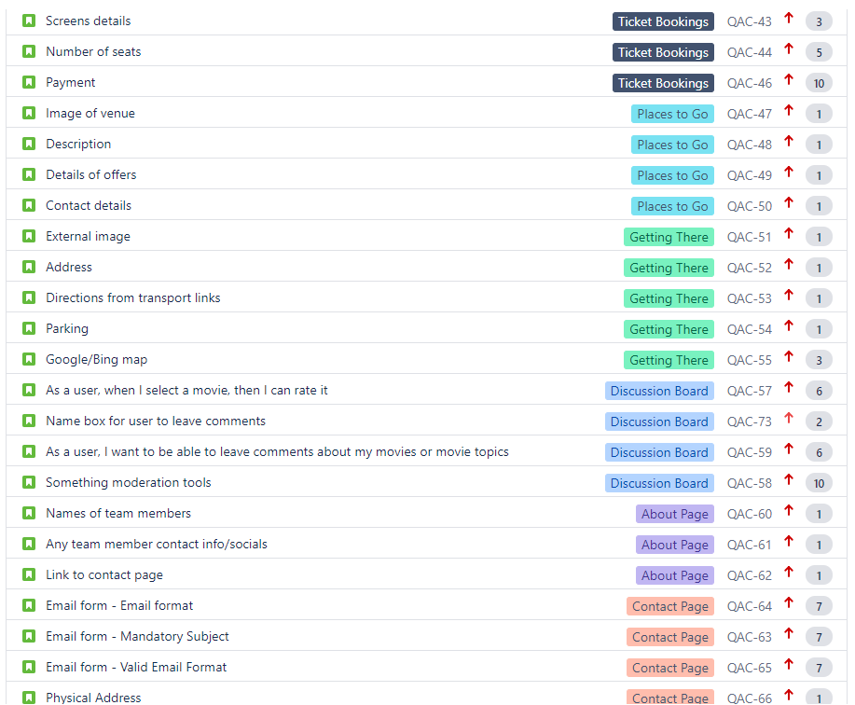
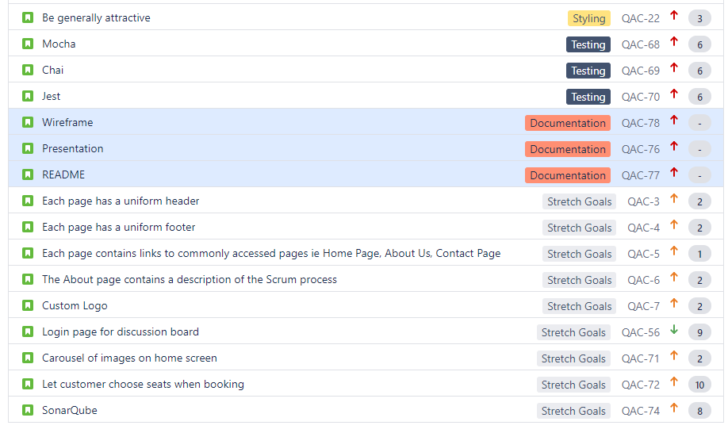

Slide 8




Consultant Journey
So what have we learnt?
MongoDB
Express
React
Node
Jest
Mocha
Chai

Slide 9
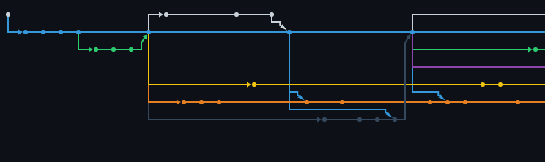
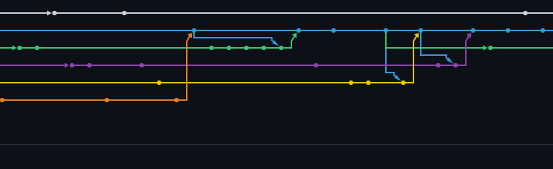
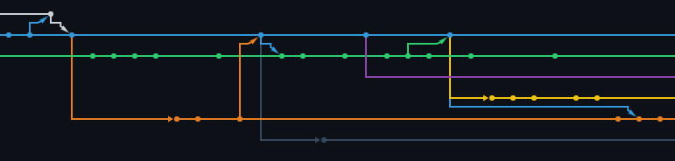
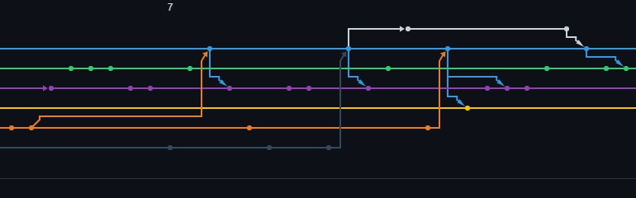
Continuous Integration

Slide 10
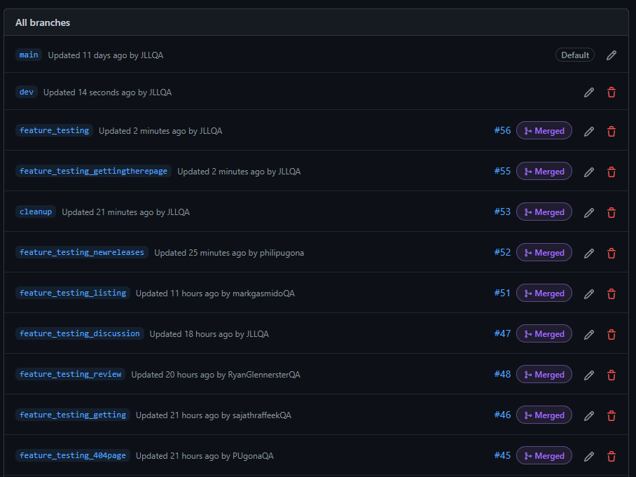
Continuous Integration

Slide 11
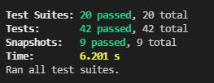
Testing

Slide 12
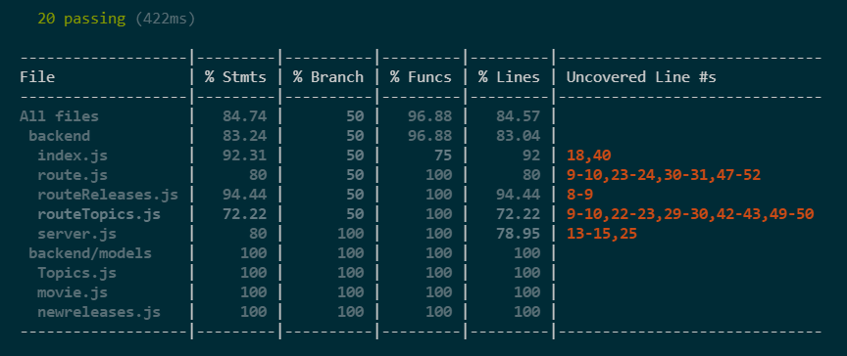
Testing

Slide 13
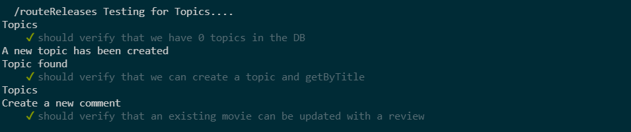
Testing

Slide 14
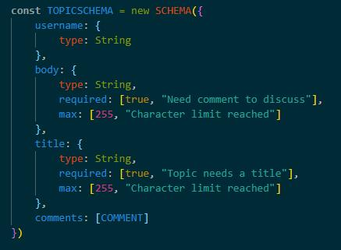
Testing

Slide 15
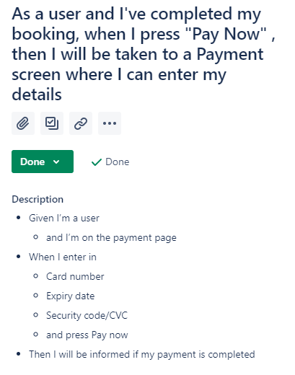
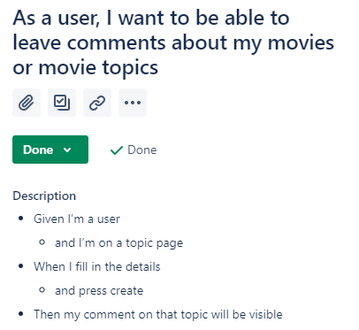
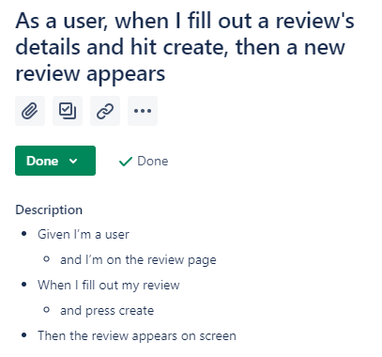
Demonstration

Slide 16
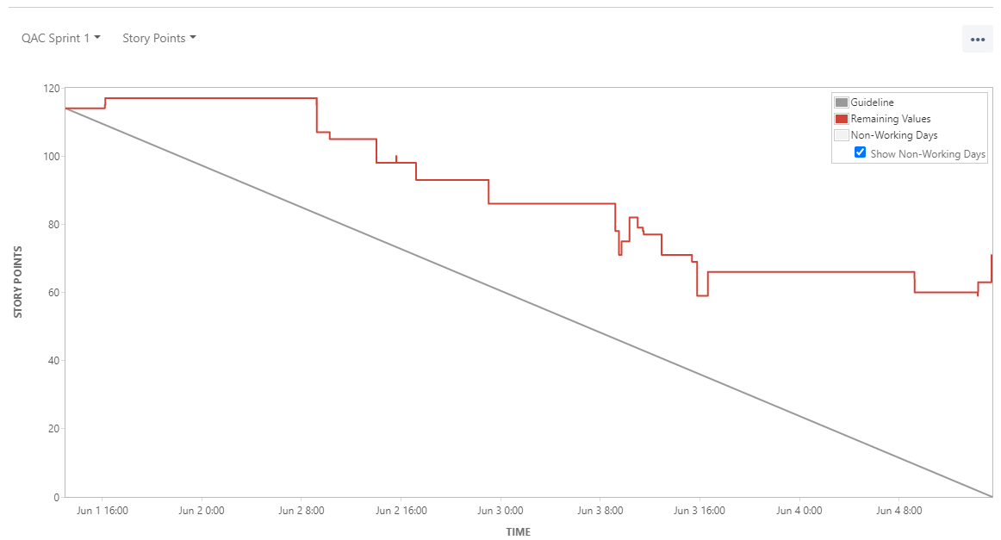
Sprint Review
In a traditional sprint review, the product owner and key stakeholders are present to discuss the work done and to adapt the backlog moving forward. With our project, we had only ourselves in the meeting, so we presented the parts of the website we each made to each other.
We had a system where we had mini sprint review-esque meetings after lunch and at the end of the day to ensure that we were all on the same page.

Slide 17
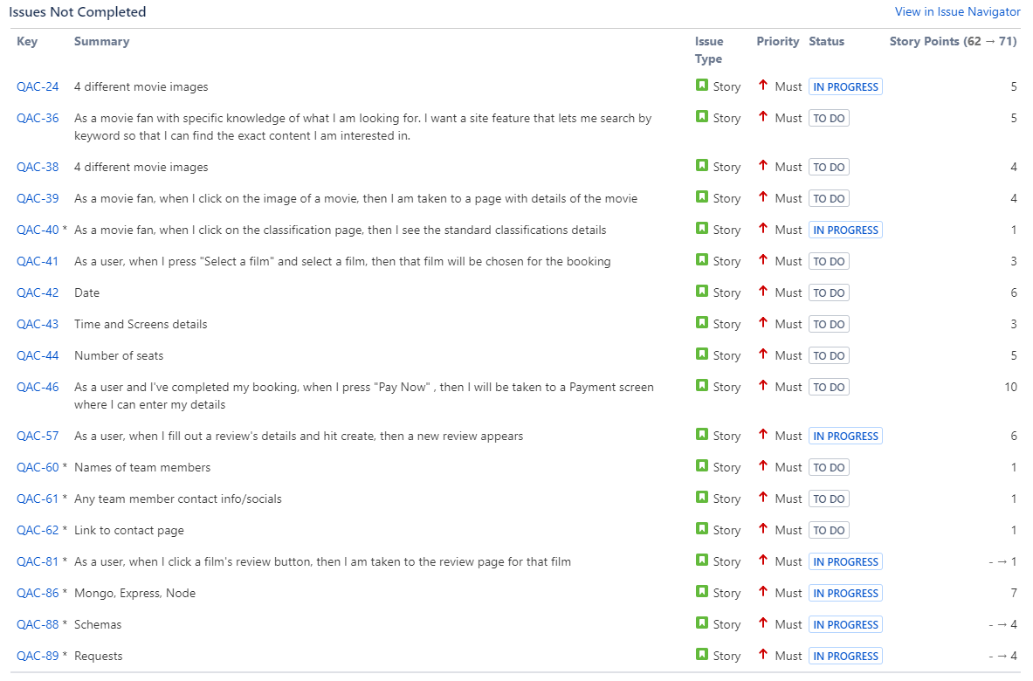
Sprint Review

Slide 18
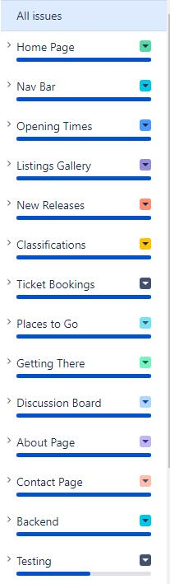
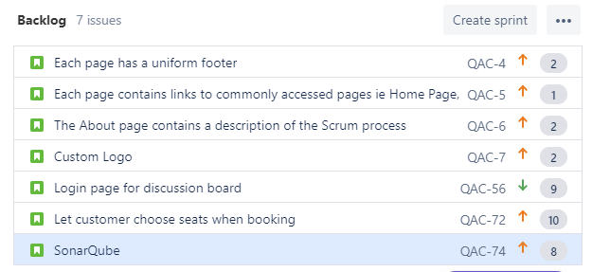
Sprint Review

Slide 19
Sprint Retrospective
Initial sprint went very well.
We were able to create the skeleton of the website together and got comfortable working in varying group sizes.
A clear plan was created that we could all refer back to.
Next Sprint:
One page/feature worked on per person
Meeting every few hours
One member responsible for uniform styling

Slide 20
Conclusion
Project is a success
Immensely pleased with the outcome
Teamwork
K.I.S.S. mentality
Room for improvement
QA Cinemas 2: Electric Boogaloo?

